Slide 1
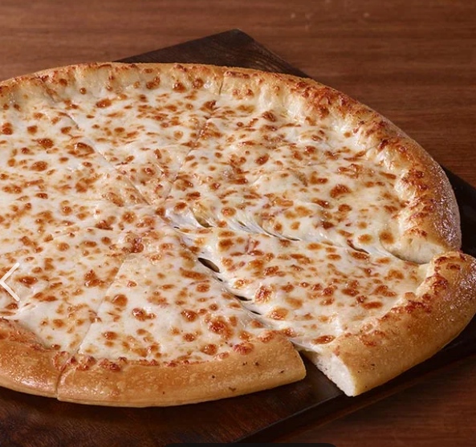
Pizza Store Analysis Using MySQL
Unveiling Insights & Trends prepared by Abir Abrar Fahim

Slide 2
About Data Landscape
Order Details
Customer Details, Pizza Order Information
Orders
Order ID, Date, Time, Total Amount
2015 (January - December)
Pizza Types
Pizza Category, Description, Price
Pizzas
Pizza ID, Size, Price

Slide 3
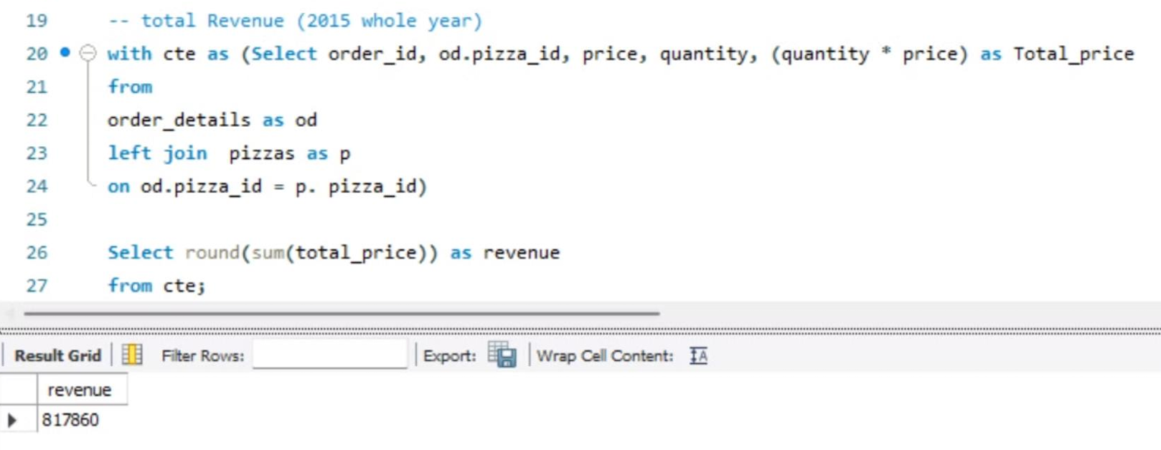
Total Revenue: 8,17,860$
For the Year 2015

Slide 4
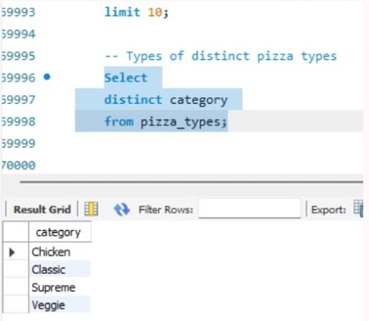
Pizza Categories
Classic
chicken
veggie
supreme

Slide 5
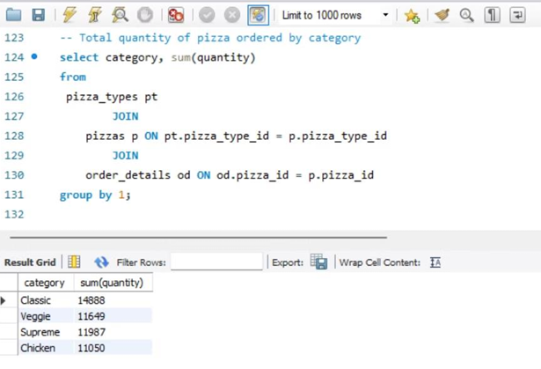
QUANTITY OF PIZZA ORDERED BY CATEGORY
Highest Ordered Category- Classic

Slide 6
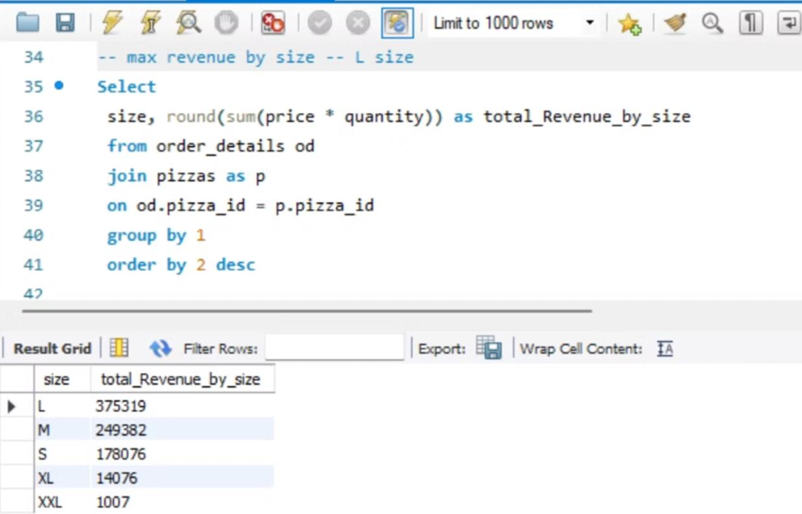
Demanding Pizza Size : L-Size

Slide 7

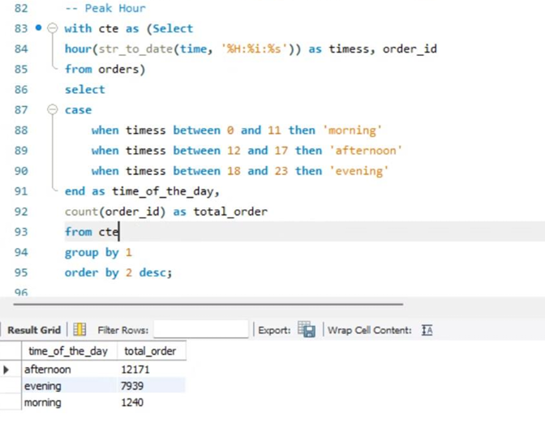
Peak Order Time
Afternoon
Evening
Morning

Slide 8
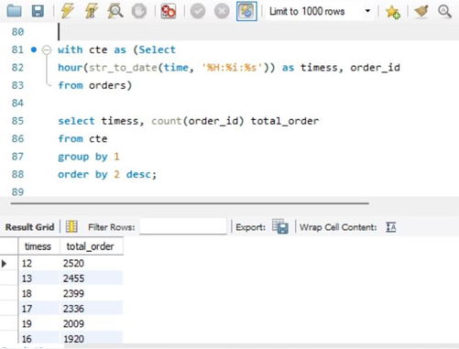
Highest Hourly Order
12 PM

Slide 9
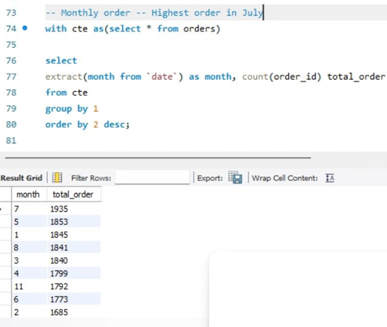
Highest Monthly Order
July 2015

Slide 10
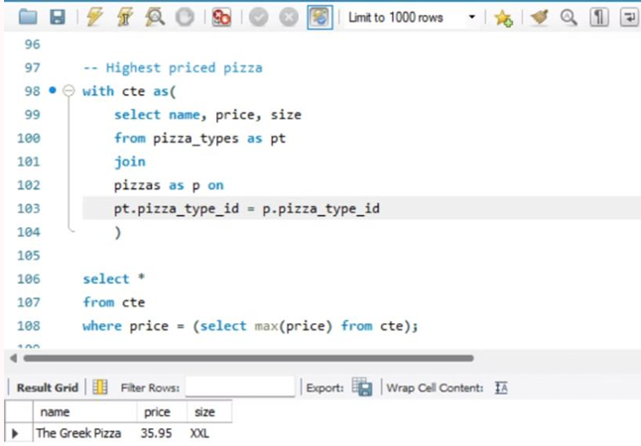
Highest Pizza Price
The Greek Pizza

Slide 11
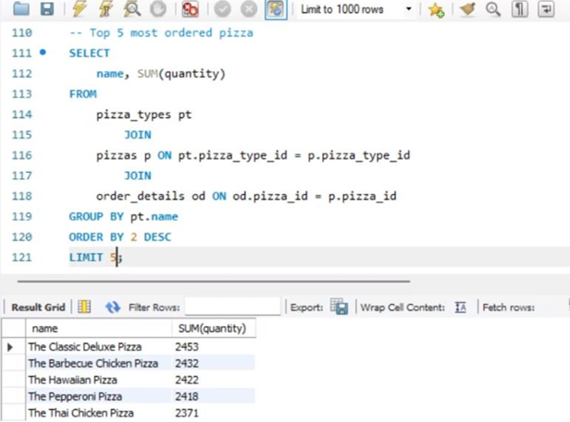
Top Pizzas
Top 5 most ordered pizza (quantity)

Slide 12
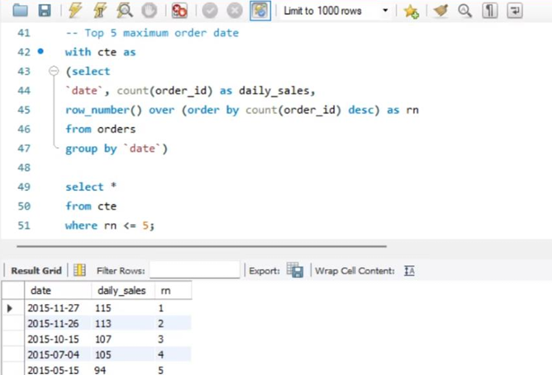
Top Pizzas
Top 5 Max Order Date

Slide 13
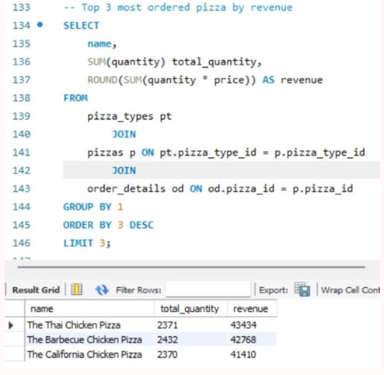
Top Pizzas
Top 3 Most Ordered Pizzas & Revenue

Slide 14
Thank you
Abir Abrar Fahim
abir.abrar.1998@gmail.com

